Slide 1

Datta Meghe College of Engineering, Technology & Research

Slide 2

DEPARTMENT OF ELECTRONICS ENGINEERING
Project Incharge:
DR. RAJENDRA REWATKAR Sir

Slide 3

Team Members:
ETRX
Deepak Pashine
Nutan Deode
Dhiraj Thakre
Sayali Raut
Mayur Pandharkar

Slide 4
PROBLEM STATEMENT
COVID-19 is a global disaster affecting economies throughout the globe. Many industries see massive monetary losses, and businesses are going bankrupt.
Although unlock process is started still many industries facing problem due to increasing rate of Covid positive patients, it is not possible to close working after detection of individual positive employee.
Also it is difficult to find contacted employees with Covid positive employee.

Slide 5
Project Seminar on Novel approach to detect contacted people with Covid +ve person using IOT.

Slide 6
Contents
Introduction
Literature review
Objectives
Modules
System requirements
References

Slide 7
Introduction : Diagnosis of COVID-19
All countries are striving to control COVID-19
Typical clinical analysis like blood test report, ct scan images etc are available.
Some Artificial Intelligence enabled framework reads Smartphone sensors, signal measurement to predict the grade of severity as well as result of diseases.
It is difficult to find contacted people in case of CORONA in huge organisation.

Slide 8
Literature review:
Sr. No | Papers Title | Name of Author | Publisher | Work Reported
1 | A Novel AI enabled framework to diagnose corona virus COVID-19 using Smartphone Embedded sensors: Design study. | Halguard S. Maghdid, Kayhan Zrar Ghafoor, Ali Safa Sadiq, Kevin Curran,Danda B. Rawat,Khaled Rabie |  | The design Artificial Intelligence enabled framework read s the Smartphone sensors signal measurements to predict the grade of severity of the pneumonia as well as predicting the result of the disease.

Slide 9
Sr. No | Papers Title | Name of Author | Publisher | Work Reported
2 | Artificial Intelligence(AI) and Big Data for CoronaVirus Pandemic: A survey on the state of the Arts | Quoc Viet Pham, Dinh C. Nguyen, Thien Huynh The, Won Joo HwNG, Pubudu N. Pathirana | IEEE Access | Proposed a application of AI for COVID-19 detection and diagnosis, tracking and identification of the outbreak, infodemiology and infoveillance biomedicine and pharmacotherapy.

Slide 10
Objectives:
Digital ID card to detect contacted people with COVID positive person.
Device can be transmit and receive data and can save 2000 device data.
To implement software who controls distance of a hardware device to detect persons.
Multi company and many users can use the device.
Superadmin to control activities of multiple company.
QR code generation for person identification.

Slide 11
System requirements
Hardware
Transmitter and receiver sensor
Software
.NET
Windows O.S
MySQL

Slide 12
Software Requirement:
Technology: Microsoft .Net Technology
Framework: Dot. Net Framework 4.5.2 , Bunifu Framework, Guna Framework
Back End Language: VB.Net
Database: Mysql (Web Server)
IDE: Visual Studio 2015, MP Lab Software
OS: Windows 7, Windows 10
Hardware Requirement:
Processor: Intel Dual Core
RAM: 2 GB
HDD: 160 GB

Slide 13
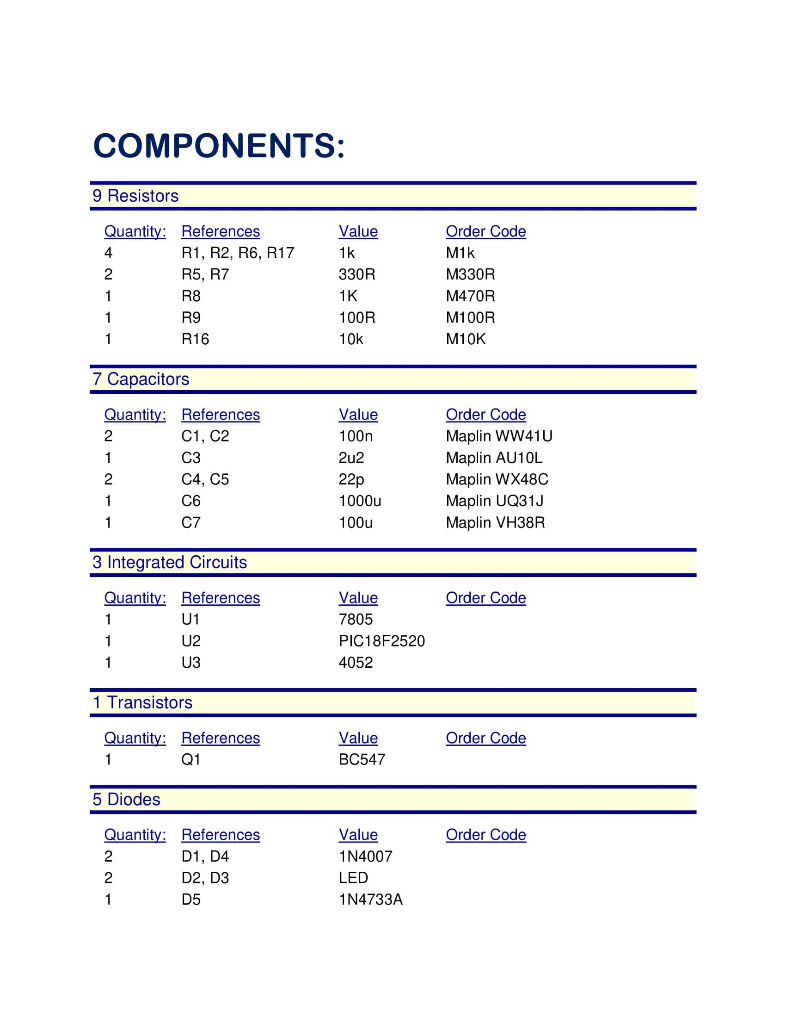

Slide 14
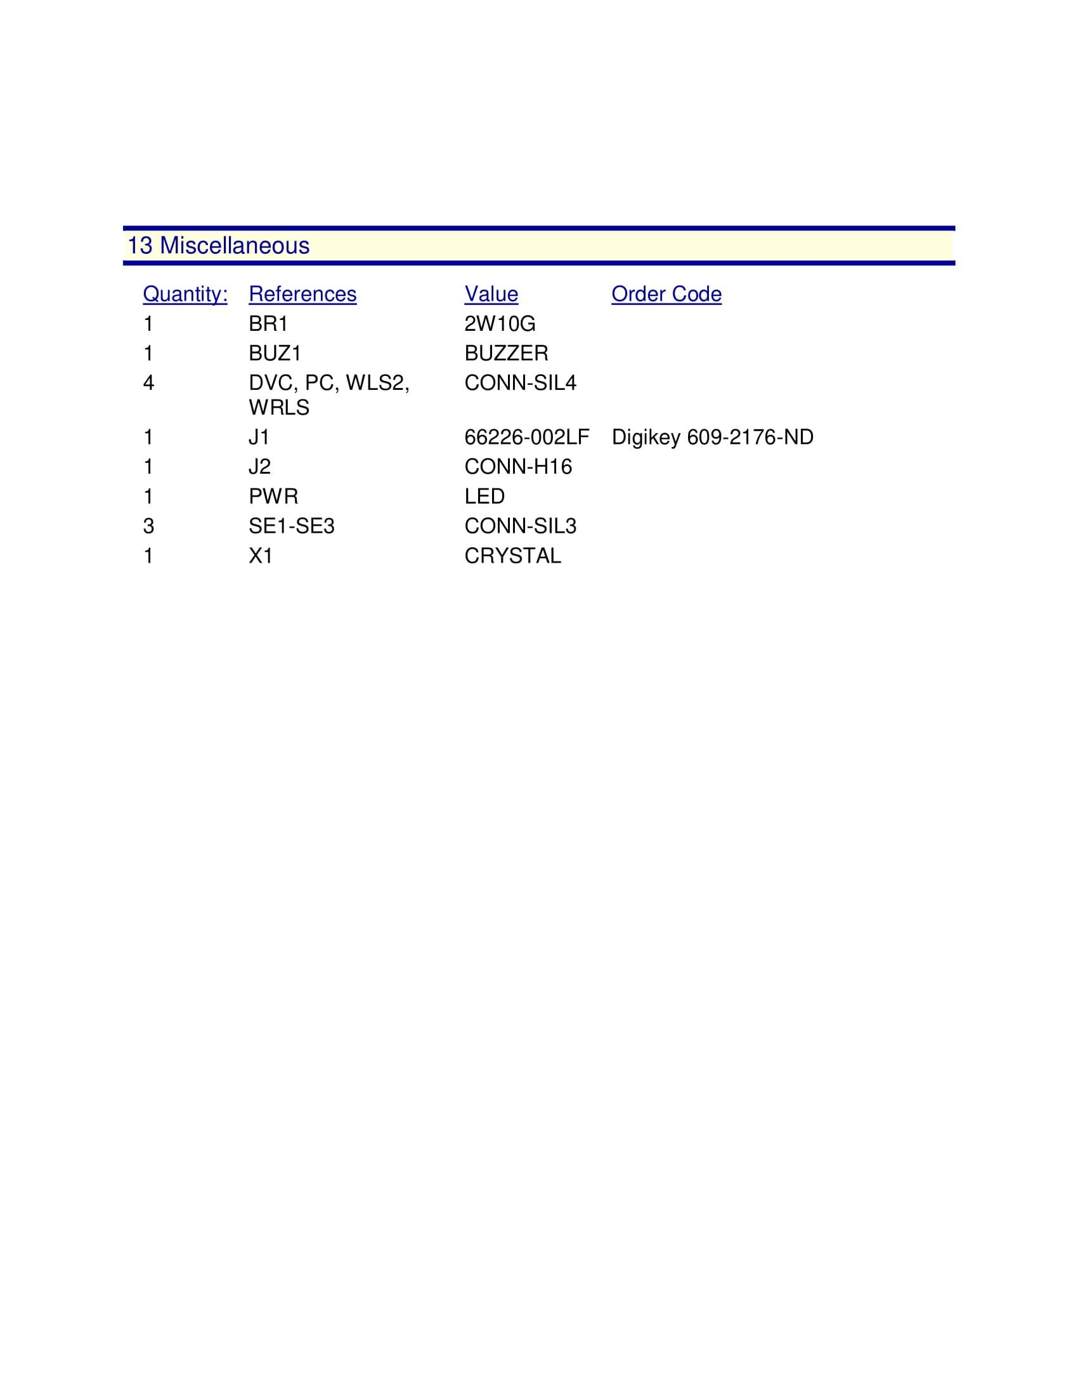
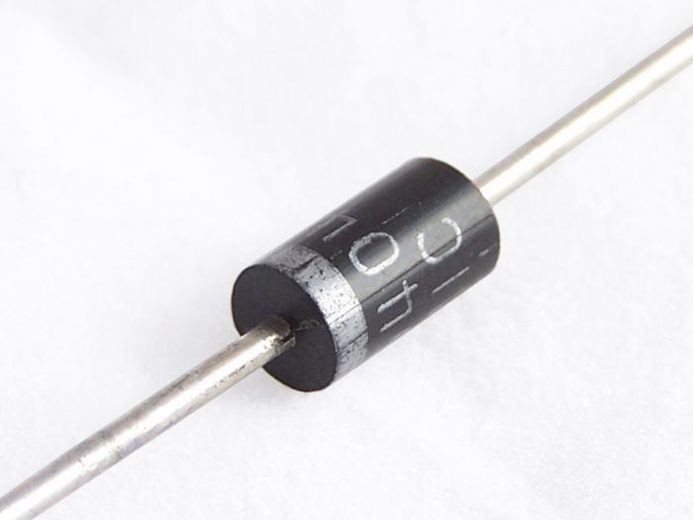
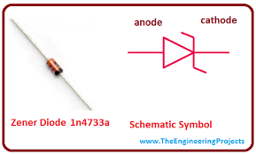
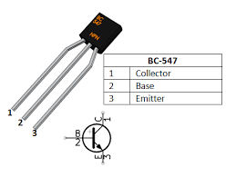
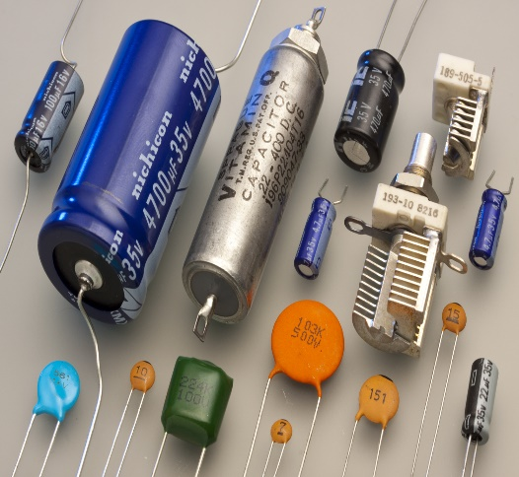
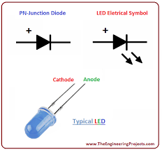
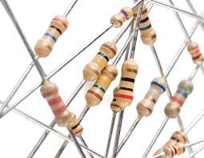

Slide 15
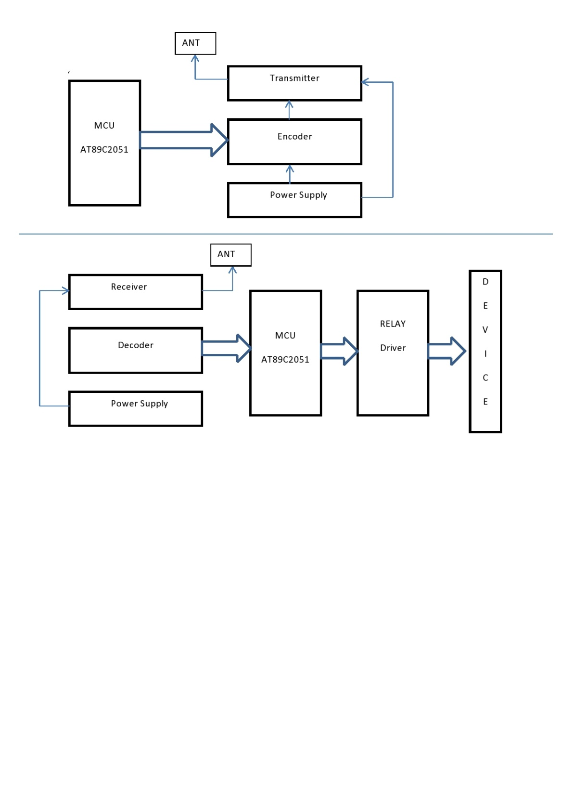
BLOCK DIAGRAM

Slide 16
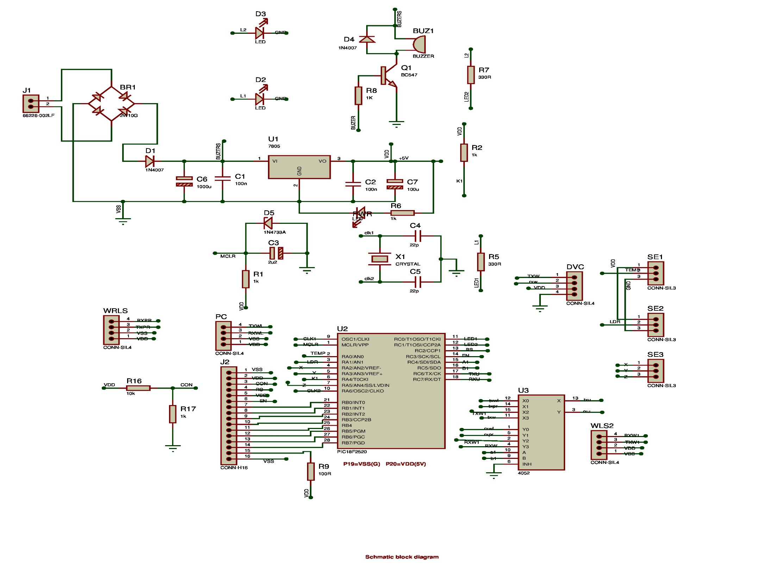
CIRCUIT DIAGRAM

Slide 17
Modules:
QR Code generation
Device data control
Device issue, return.
Superadmin control.

Slide 18
QR Code Generation:
The device can be use as a digital ID card of user.
Can get details of user.
Can be use to check attendance of user.

Slide 19
Device Data Control:
The device can store 2000 device data.
Users Data can be collected in software, also contacted person log is also get recorded.
Distance ie range of data transmission in a device can be control using software.

Slide 20
Superadmin Control
With the help of software we can create many company many user scenario.
Superadmin can handle the permission to access device in many companies.
Superadmin can control device access to company as well as user too.

Slide 21
Device issue and return
The device can be issue by user if he is new to the organisation.
If person left the organisation, have to return device.
Superadmin can control device issue , return activities.

Slide 22
Applications:
High security and assurance – This identification provides the answers to “something a person has and is” and helps verify identity.
User Experience – Convenient and fast.
Digital Id cards will be used in several areas like Industries,schools/colleges,banks,government sectors etc.i.e the places where people are coming in bulk regularly.

Slide 23
References
[1] “Coronavirus disease pandemic”,2020 (online available): http//www.who.int/emergencies/diseases/novel-coronavirus-2019.
[2] J. Chen, L. Wu, J. Zhang, L. Zhang, D. Gong, Y. Zhao, S. Hu, Y. Wang,X. Hu, B. Zheng ef a/., “Deep learning-based model for detecting 2019novel coronavirus pneumonia on high-resolution computed tomography:a prospective study,” medRxiv, 2020.
[3] M. Holshue, C. DeBolt, and L. S. First, “Novel coronavirus in the unitedstates,” N Engl J Med, vol. 2020, p. 31, 2019.
[4] “Novel coronavirus — china. world health organization.” https://www.who.int/csr/don/12-january-2020-novel-coronavirus-china/en/.,Accessed in March, 2020.

Slide 24
[5] “Cnn health,” https://edition.cnn.com/2020/03/1 1/health/coronavirus-pandemic-world-health-organization/index.html, Accessed in March,2020.
[6] “Novel coronavirus (2019-ncov). world health organization.”https://Awww. — who.int/emergencies/diseases/novel-Coronavirus-2019,,Accessed in March, 2020. eek ure) ee y TC Rel)tT no 2 FF TFT ao 2 -@f

Slide 25
THANK YOU

